Slide 1
DATABASE SYSTEMS ENGINEERING AND DISTRIBUTED BACKEND DEVELOPMENT
Shipment Management & Analytics Portal for Logistics & Supply Chain
TEAM MEMBERS:
MANASWI - 2520030411
NAMBURI TEJA SRI – 2520030139
Team number – 13
Guide : Dr. R. Sateesh Kumar

Slide 2

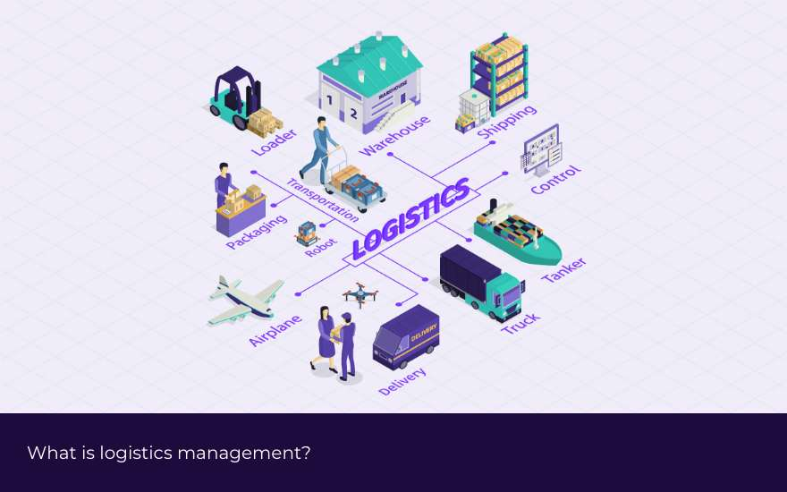
Abstract
The Shipment Management & Analytics Portal for Logistics & Supply Chain is a web-based system designed to simplify and improve the management of shipments and logistics operations. The system provides a centralized platform for managing shipment details, tracking delivery status, monitoring orders, and maintaining customer and delivery information.
The portal allows users to add, update, and track shipments throughout different stages such as processing, dispatched, in transit, and delivered. It also provides an analytics dashboard that presents useful information such as the number of shipments, delivery performance, delayed shipments, and overall shipment trends. These insights help logistics teams identify problems and make better decisions.
By combining shipment management, real-time status tracking, and data analytics in one platform, the proposed system reduces manual work, improves visibility, and increases operational efficiency. The portal can be useful for logistics companies, warehouses, suppliers, and businesses involved in supply chain management.

Slide 3
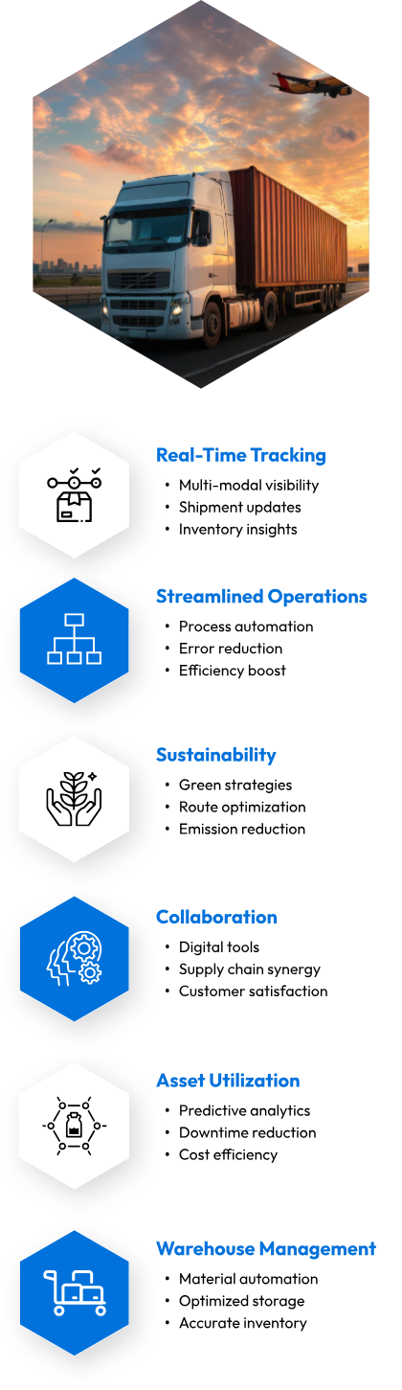
Problem Statement
In logistics and supply chain operations, managing a large number of shipments manually can be difficult, time-consuming, and error-prone. Organizations often face challenges in tracking shipment status, identifying delayed deliveries, maintaining accurate shipment records, and monitoring overall delivery performance. When shipment information is stored across different systems or handled manually, it becomes difficult to get a complete view of the supply chain.
There is a need for a centralized Shipment Management & Analytics Portal that can manage shipment information, track deliveries, monitor shipment progress, and provide useful analytical insights. The proposed system aims to reduce manual effort, improve shipment visibility, identify delays, and help logistics teams make better data-driven decisions.

Slide 4
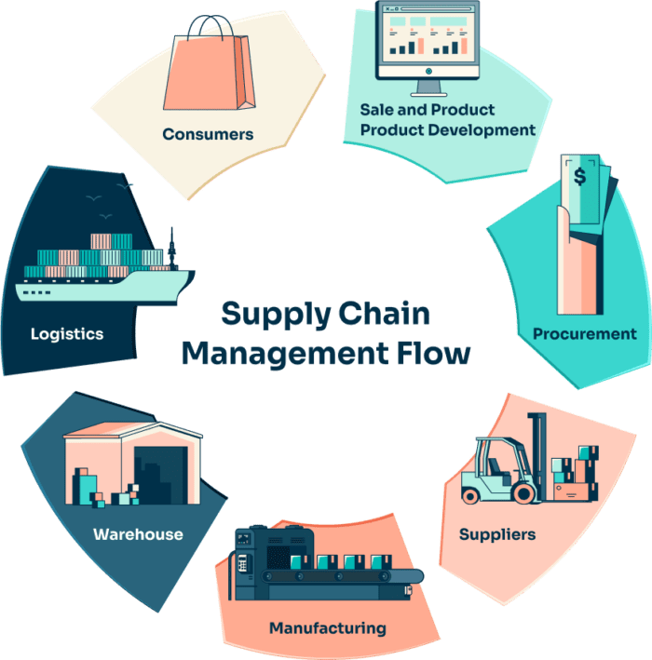
Proposed Solution
The proposed system is a web-based Shipment Management & Analytics Portal that provides a centralized platform to manage and track shipments. It allows users to update shipment status, monitor deliveries, identify delays, and view important data through an analytics dashboard. This helps reduce manual work, improve visibility, and make logistics operations more efficient.

Slide 5
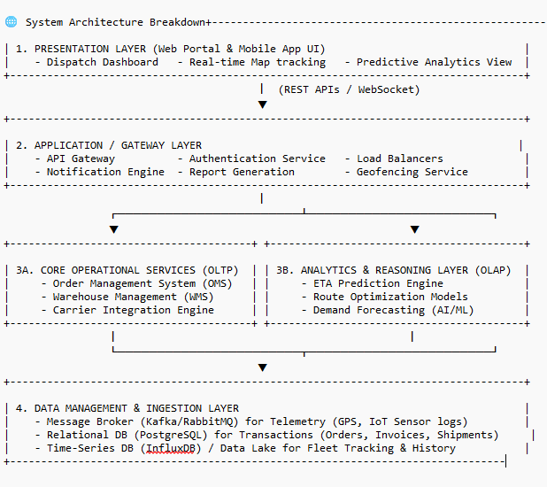
System Architecture
The system follows a three-layer architecture:
Frontend Layer – Provides the user interface for adding shipments, tracking deliveries, and viewing analytics.
Backend Layer – Handles shipment processing, status updates, user requests, and business logic.
Database Layer – Stores shipment details, customer information, delivery status, and analytics data.
Flow:
User → Frontend → Backend → Database
Database → Backend → Analytics Dashboard → User
This architecture provides a centralized, secure, and efficient way to manage shipment and logistics information.

Slide 6
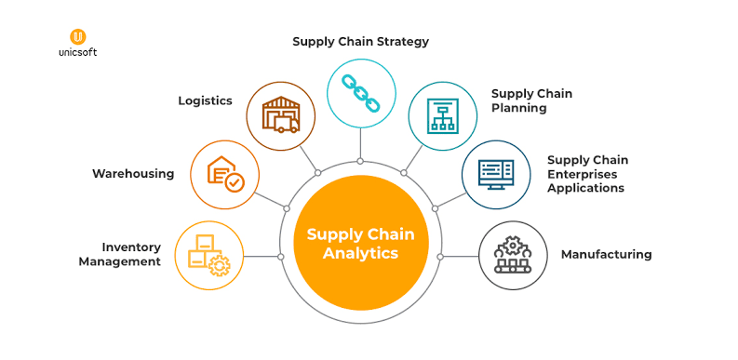
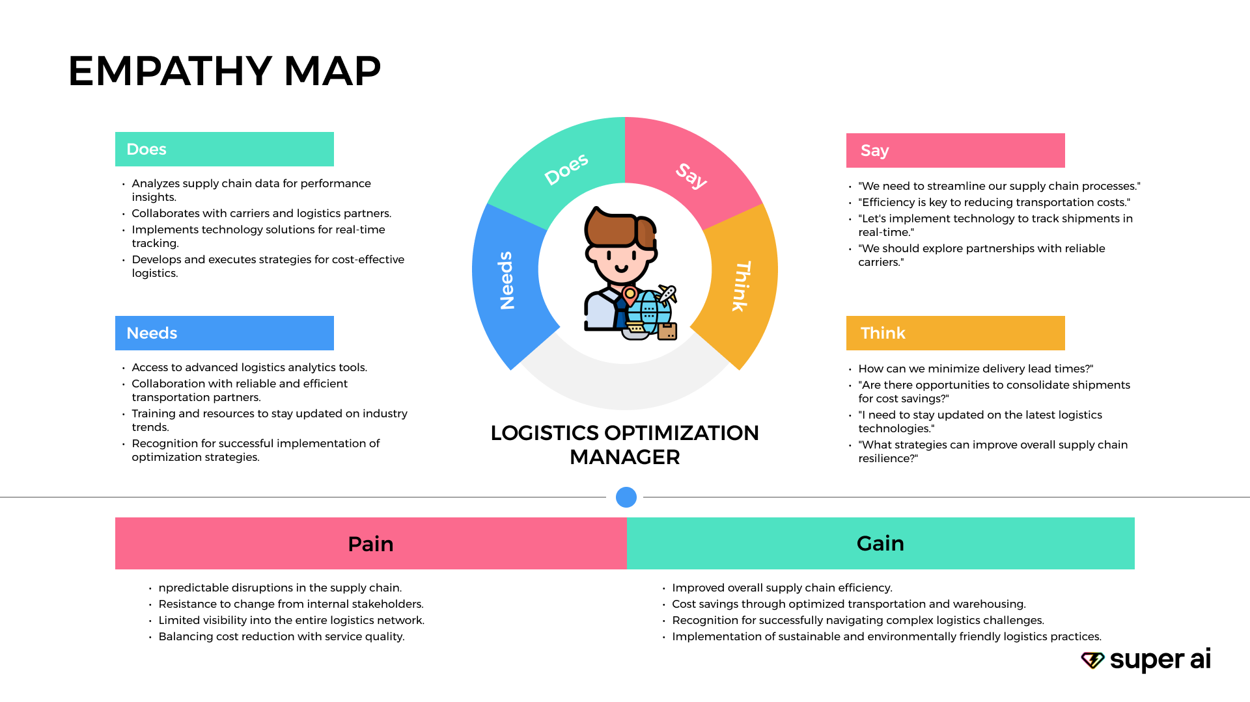
Expected Output
The system is expected to provide a user-friendly shipment management portal where users can add, update, and track shipments. It will display shipment status, delivery details, delayed shipments, and important logistics information through an analytics dashboard. The system will help improve tracking, reduce manual work, and support better decision-making.

Slide 7
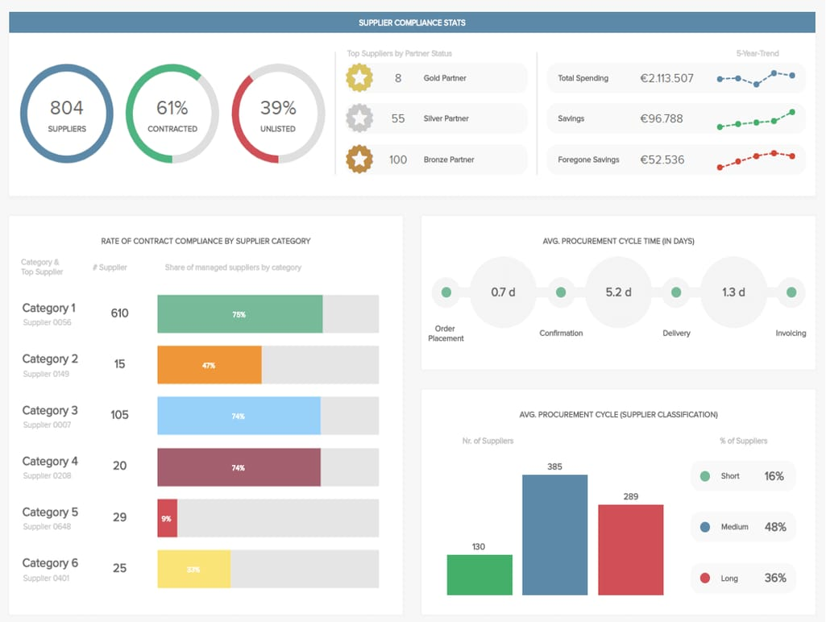
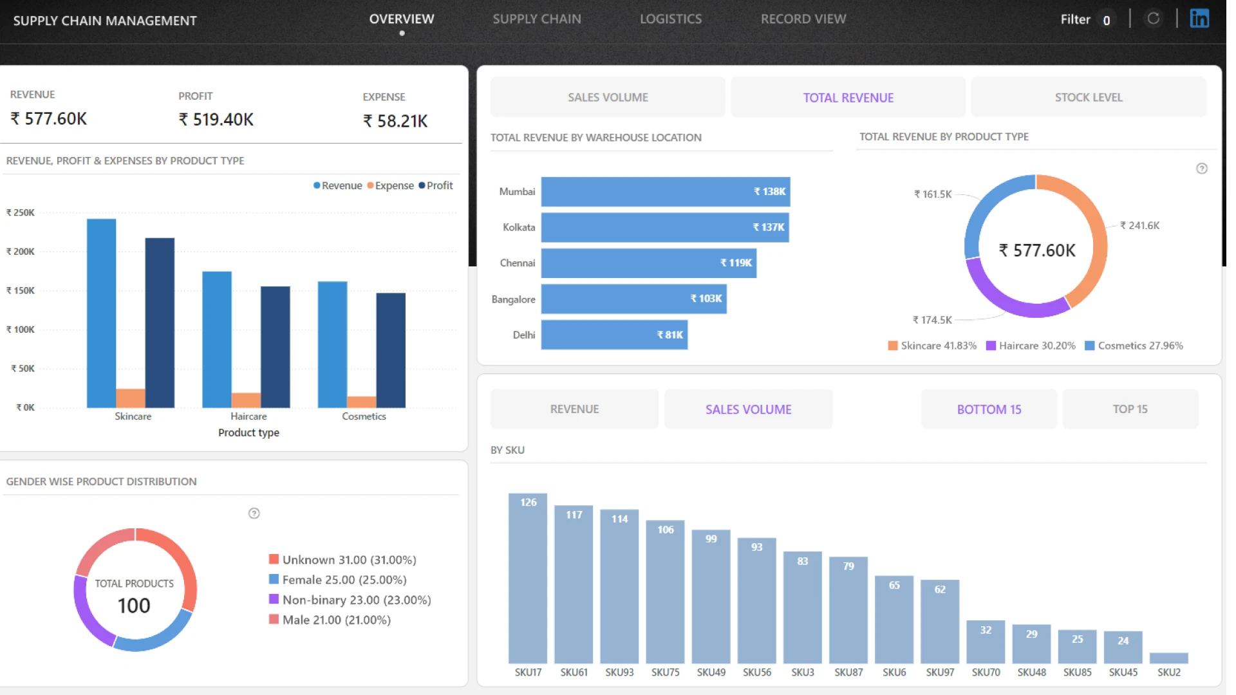
Required Tools and Technologies
Frontend: HTML, CSS, JavaScript, Bootstrap
Backend: Python with Flask
Database: MySQL
Analytics & Charts: Python, Pandas, Chart.js
Development Tool: Visual Studio Code
Testing Tool: Postman
Version Control: Git and GitHub

Slide 8
THANK YOU

